Slide 1



WELCOME TO OUR CLASS

Slide 2
RHYTHM OF THE RAIN
The only girl I care about has gone away
Looking for a brand new start
But little does she know that when she left that day
Along with her she took my heart
Rain won't you tell her that I love her so
Please ask the sun to set her heart aglow
Rain in her heart and let the love we knew start to grow
Listen to the rhythm of the falling rain
Telling me just what a fool I've been
I wish that it would go and let me cry in vain
And let me be alone again
Oh, listen to the falling rain
Pitter pater, pitter pater
Oh, oh, oh, listen to the falling rain
Listen to the rhythm of the falling rain
Telling me just what a fool I've been
I wish that it would go and let me cry in vain
And let me be alone again
The only girl I care about has gone away
Looking for a brand new start
But little does she know
That when she left that day
Along with her she took my heart
Rain please tell me now does that seem fair
For her to steal my heart away when she don't care
I can't love another when my hearts somewhere far away
Pitter pater, pitter pate

Slide 3
UNIT 8 : CELEBRATIONS
LESSON 5 : LANGUAGE FOCUS

Slide 4
A- RELATIVE CLAUSES
EX: Te t is . occurs in late January or early February.
a festival
It
Tet is
which
occurs in late January or early February.
Relative clause
is blue . is on the table.
This book
It
, which is on the table ,
is blue
1. Easter is a joyful festival. It is celebrated in many countries.
2.This building is a library . It was built ten years ago.
------>Easter is a joyful festival which is celebrated in many countries.
------>This building , which was built ten years ago, is a library.

Slide 5
EX:. likes playing guitar lives on Trang Tien Street.
Ba
He
,who
lives on Trang Tien Street,
likes playing guitar.
Ex: Mrs Hoa is is wearing a blue dress.
the woman.
She
Mrs Hoa is the woman
who
is wearing a blue dress.
1. Lan is the girl . She is sitting behind me.
2. This is Huong. She is my close friend.
Lan is the girl who is sitting behind me.
This is Huong who is my close friend.

Slide 6
1. JOIN THE SENTENCES. USE RELATIVE CLAUSES
Auld Lang Syne is a song. Auld Lang Syne is sung on New Year’s Eve.
This watch is a gift. The watch was given to me by my aunt on my 14th birhtday.
My friend Tom can compose songs . Tom sings Western folk songs very well.
We often go to the town cultural house. The town cultural house always opens on public holidays.
I like reading books. Books tell about different peoples and their cultures.
On my mom’s birthday my dad gave her roses. The roses were very sweet and beautiful.
Judy liked the full-moon festival very much. The festival is celebrated in mid-fall.
Tomorrow I’ll go to the airport to meet my friends. My friends come to stay with us during the Christmas
Auld Lang Syne is a song which is sung on New year’s Eve.
This watch is a gift which was given to me by my aunt on my 14th birthday.
My friend Tom, who sings Western folk songs, very well can compose songs .
We often go to the town cutural house, which always opens on public holidays
I like reading books which tell about different peoles and their cultures.
On my mom’s birthday my dad gave her roses ,which were very sweet and beautiful.
Judy liked the full – moon festival ,which is celebrated in mid- fall, very much .
Tomorrow I’ll go to the airport to meet my friends, who come to stay with us during the Christmas.

Slide 7

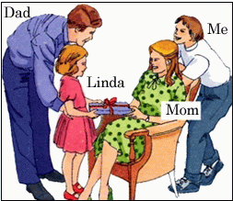
2. Describe each of the people in the pictures. Use relative clause.
Dad / the man / stand / his daughter
Dad is the man who is standing behind his daughter
I/ the boy/wear / a white T-shirt
I am the boy who is wearing a white T -shirt
Mom/ the woman / sit / an armchair.
Mom is the woman who is sitting on an armchair
Linda / the girl / give / her mom / a gift
Linda is the girl who is giving her mom a gift

Slide 8

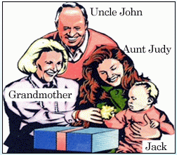
Uncle John / the man / wear/ a pink jumper
Uncle John is the man who is wearing a pink jumper.
Grandmother / the woman / give / Jack / a gift.
Grandmother is the woman who is givingJack a gift.
Aunt Judy / the woman / hold / Jack
My Aunt Judy is the woman who is holding Jack.
Jack /the boy / sit / his mother’s lap
Jack is the boy who is sitting on his mother’s lap.

Slide 9
B. Adverb clauses of concession
Although / Even though / Though
EX : a/ Thu Ha is not satisfied with her preparations for Tet . Thu Ha has decorated her house and made plenty of cakes.
Thu Ha is not satisfied with her preparations for Tet though she has decorated her house and made plenty of cakes.
Though Thu Ha has decorated the house and made plenty of cakes, she is not satisfied with her preparations for tet.

Slide 10
3.Join the sentences. Use the words in bracket.
b. We don’t have a Mother’s Day in Viet Nam . Dad and I have special gifts and parties for mom every year on the 8th of March. (although)
c. We went to Ha Noi to watch the parade on National Day last year. We live in Nam Dinh. (even though)
d. Many tourists enjoy festival in Viet Nam. Tourists do not understand Vietnamese cultures very much. (though)
e. In Australia, Christmas season is in summer. The Australian enjoy Christmas as much as people in European countries do . (even though).
f. Jim could see the main part of the show. He came to the show late due to the traffic jam. (although).
Although we don’t have a Mother’s Day in Viet Nam, Dad and I have special gifts and parties for mom every year on the 8th of March.
We went to Ha Noi to watch the parade on National Day last year even though we live in Nam Dinh
Many tourists enjoy festival in Viet Nam though they do not understand Vietnamese culture very much.
Even though in Australia, Christmas season is in summer, the Australians enjoy Christmas as much as people in European countries do.
Jim could see the main part of the show although he came to the show late due to the traffic jam.

Slide 11
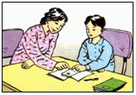
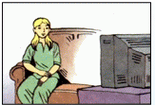
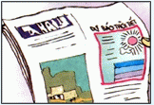
a/ help / Tuan / homework
a. Although Mrs Thoa was tired, ……………………………………
Although Mrs Thoa was tired, she helped Tuan with his homework.
b/ watch / TV
b.Even though Liz has an exam tomorrow,……………………….
Even though Liz has an exam tomorrow, she is still watching TV now.
c/ the weather bureau / predict fine weather
c. It rained yesterday, although………………………………
It rained yesterday although the weather bureau predicted fine weather.

Slide 12
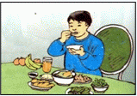
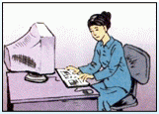
d/ Ba / eat / lot / food
d. …………………………. though he wasn’t very hungry.
Ba ate a lot of food though he wasn’t very hungry.
e/ finish / / letter
e. Even though the keyboard wasn’t working well ………………………………………
Even though the key board wasn’t working well, Mary tried to finish her letter.

Slide 13

Lucky number

Slide 14
1
2
3
4
5
6
8
7

Slide 15
Easter is a joyful festival _______ is celebrated in many countries.
which

Slide 16
Linda is giving her Mom the present ______ was bought yesterday.
which

Slide 17
Lucky number

Slide 18
Ba ate a lot of food _______he wasn’t very hungry.
though

Slide 19
___________there are many celebrations throughout the year, Tet or Lunar New year holiday is the most celebration for Vietnamese people.
Because
Although
But
So

Slide 20
who
Dad is a person _________ is standing behind his daughter.

Slide 21
Lucky number

Slide 22

It rained heavily yesterday , _________the weather bureau predicted fine weather
and
but
so
because

Slide 23

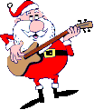
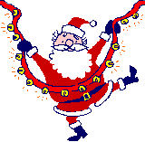
Homework
Write the exercises into your book.
Resee the exercise
Prepare for the next lesson. Unit 9 Lesson 1: Getting started- Listen and Read

